Slide 1
Group The Unknown
Gökçenur Duran
Chingis Safarov
Zeynep Gökçe Tarlakazan
Onur Tahmaz
Orçun Çelik

Slide 2
Our Datasets
Economic Freedom Index: The index measures economic freedom under 4 pillars. The Index measures 12 specific components of economic freedom, each of which is graded on a scale from 0 to 100.
We obtained the data from https://www.heritage.org/.
We used data from 2019. The 2019 data is collected between second half of 2017 through the first half of 2018.
We also used GDP per capita data for 2018, obtained from World Bank.

Slide 3
Features of Economic Freedom Index
Rule of Law (property rights, government integrity, judicial effectiveness)
Government Size (government spending, tax burden, fiscal health)
Regulatory Efficiency (business freedom, labor freedom, monetary freedom)
Open Markets (trade freedom, investment freedom, financial freedom)

Slide 4
Summary Statistics of Data
 | Mean | Standard Devaluation | Variance | Median
2019 Score | 60,8 | 11,22441523 | 125,99 | 60,75
Property Rights | 52,3 | 19,55545813 | 382,42 | 50,10
Judical Effectiveness | 44,9 | 18,055747 | 326,01 | 42,90
Government Integrity | 41,5 | 19,73962492 | 389,65 | 35,50
Tax Burden | 77,2 | 13,17157305 | 173,49 | 78,05
Gov't Spending | 64,2 | 23,08764334 | 533,04 | 68,80
Fiscal Health | 66,0 | 31,67725374 | 1003,45 | 80,30
Business Freedom | 63,5 | 15,75656765 | 248,27 | 64,30
Labor Freedom | 59,4 | 14,31668405 | 204,97 | 59,90
Monetary Freedom | 75,1 | 11,19355763 | 125,30 | 77,80
Trade Freedom | 74,3 | 12,22803324 | 149,52 | 76,10
Investment Freedom | 57,3 | 22,51074557 | 506,73 | 60,00
Financial Freedom | 48,8 | 19,43008385 | 377,53 | 50,00

Slide 5
Mean Values of Features

Slide 6
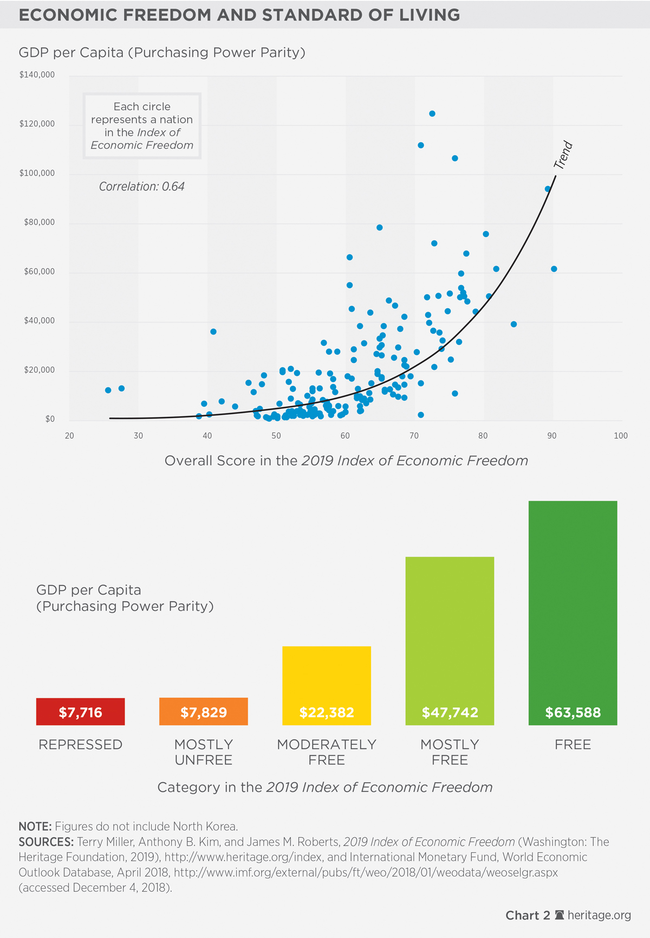
The visualization of the correlation between GDP per capita and the overall scores in Economic Freedom Index in the graph.

Slide 7
Machine Learning Methods
We want to explore the best variables in Economic Freedom Index to explain the GDP per capita levels of countries. We will use two different Machine Learning Models for our project.
Linear Regression: The model we will use to explain the relation between our variables is Linear Regression Model.
Random Forest: Another model we will use is Random Forest model which can be used for classification.

